Slide 1

Guess the Word game:
- Sneha jadhav

Slide 2
Description:
Guess the name is the game: oriented to the blank letters to be filled and guessed appropriately.
Once the letter given by the user is present in the word to be formed then it is filled in the blank space.
Each round would have the chances of guessing the letter depending on the word length.
If not able to guess then there’s the hint given.

Slide 3

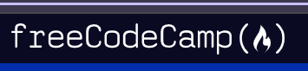
Material and tutorial used :
Youtube-
Beginner python project-coding course
https://www.youtube.com/watch?v=8ext9G7xspg&t=1465s
Youtube-
How to Make a Hangman Game with VBA. Part 1 - The Finished Game
Freecodecamp-
Hangman python project
https://www.youtube.com/watch?v=8ext9G7xspg&t=1465s

Slide 4
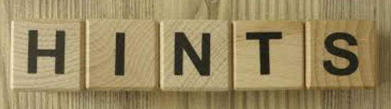
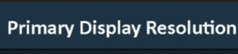
Customization Made:
Hints : The line was added to give a proper hint to guess the word.
2) Change in resolution: the size of the words was comparatively small so, increased the size and made changes in the resolution.

Slide 5
Here’s what can be learned from the above code:
Random Module:
How to use the random.choice() function to select a random item from a list.
Functions:
Creating reusable functions like choose_word, display_word, and make_guess.
How functions interact with global variables (global keyword).
String Manipulation:
Dynamically updating the word display to show guessed letters with underscores for unguessed letters.
Logic Implementation:
Tracking and managing game state using variables like guessed_letters and attempts_remaining.
Validating user input to ensure it matches the game's requirements (e.g., single alphabetic characters).
Event Handling:
How user input (via Entry and Button) triggers specific functions.
Game Mechanics:
Implementing logic for word guessing, checking for correct guesses, and determining win/loss conditions.
Message Box:
Using message box to display error messages, alerts, and game outcomes.
Dynamic Updates:
Real-time updates of the displayed word, guessed letters, and remaining attempts using .config().
Set Data Structure:
Using sets to store guessed letters, ensuring uniqueness and efficient lookups.
This code is an excellent introduction to both game logic and graphical user interface design in Python. It reinforces foundational programming concepts and demonstrates how to combine them in a practical application.

Slide 6
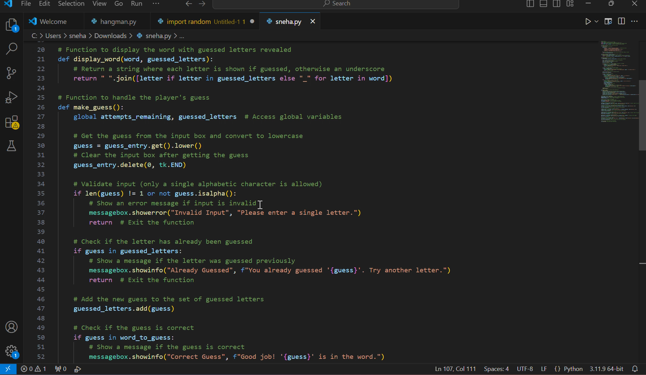

Slide 7
ThankYou…!!!

Slide 8
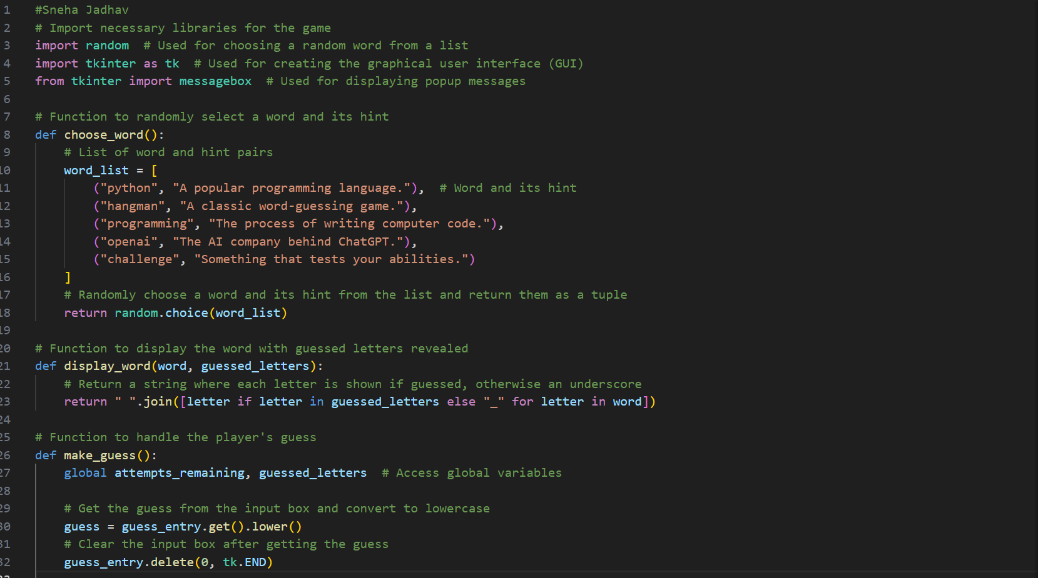

Slide 9
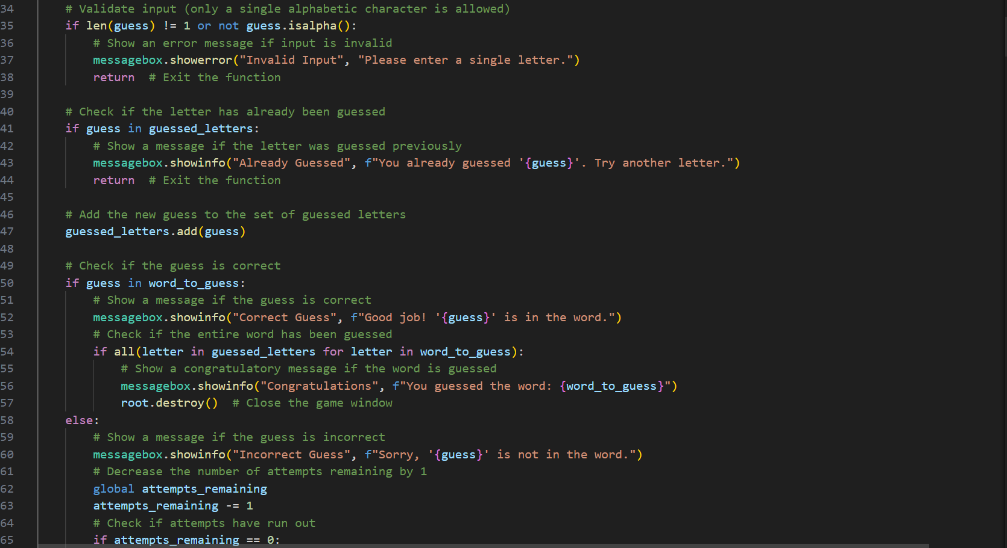

Slide 10
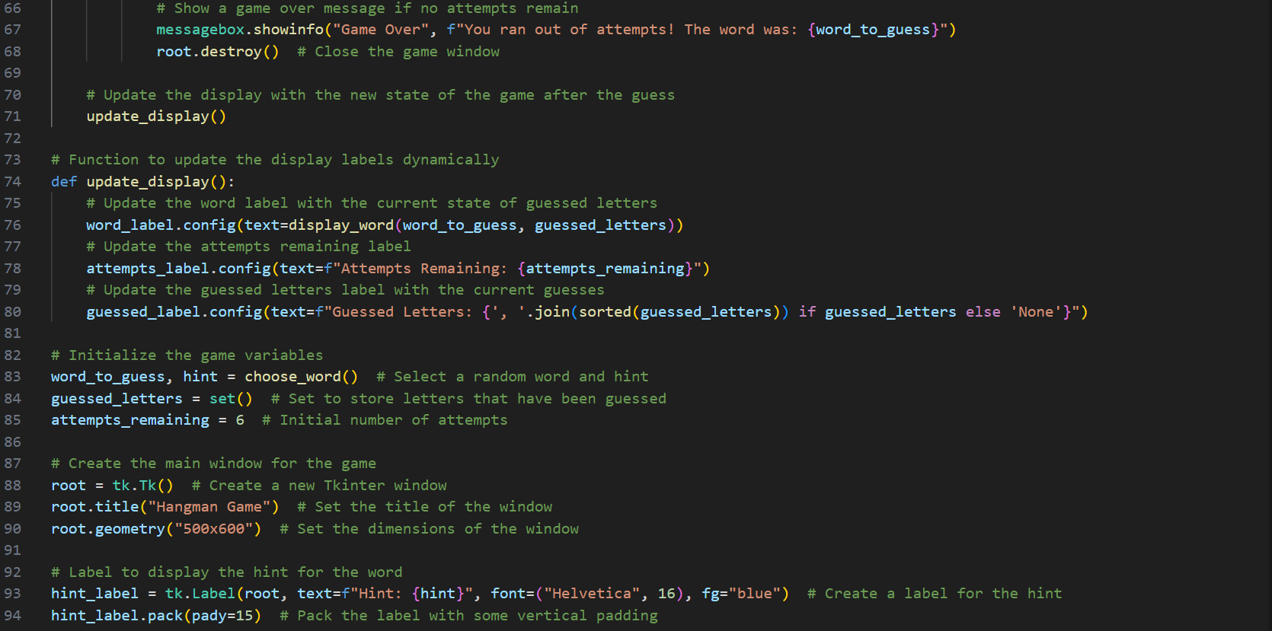

Slide 11
